Slide 1
Where are we going with Computer Based learning in Science?
Denise Whitelock
The Open University, Walton Hall,
Milton Keynes MK7 6AA
d.m.whitelock@open.ac.uk

Slide 2
Outline
Where are we now?
  Wise, CoRefelct, PI
Where are our students?
  Net generation, social networking software
What should we rethink ?

Slide 3
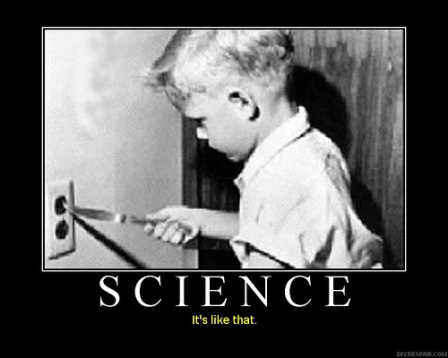

What’s this Science Stuff about?

Slide 4

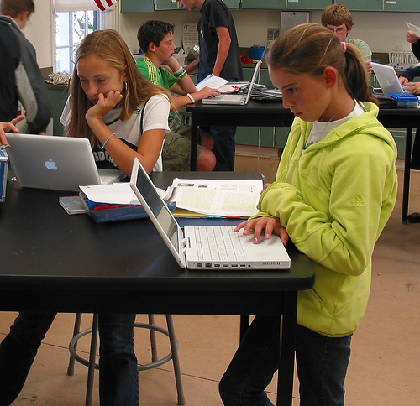
What ever it is you can do some of it better with a computer ?

Slide 5
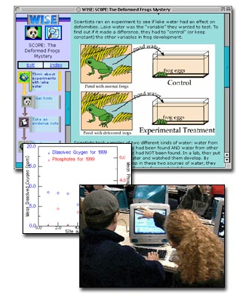
WISE - Web-Based Inquiry Science Environment
Free on-line science learning environment (in life, earth, and physical science) for students in grades 4-12
Supported by the National Science Foundation
http://wise.berkeley.edu/pages/intro/wiseIntro01.html

Slide 6
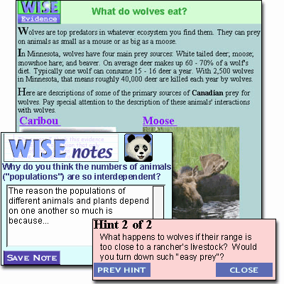
WISE
Support students to explore current science controversies and design solutions to scientific problems.
Permits teachers to customize projects to fit their curriculum and to design new activities.
Notes:
TO KNOW MORE ABOUT THE PROJECT:
WISE's interactive activities encourage analytical thinking and reflection.
WISE puts Web resources at students' disposal while focusing and directing their inquiry.
Special pop-up windows let students seek guidance and take notes while viewing and evaluating WISE evidence.
WISE's visualization and modeling tools let students organize evidence to support or refute theories, visualize relationships among variables, and analyze data.
WISE stores student work, so students can revisit and edit their work, and teachers can evaluate their work and provide feedback, all on-line.
WISE's open-ended design allows teachers to customize projects to fit their curriculum and to design new activities.

Slide 7
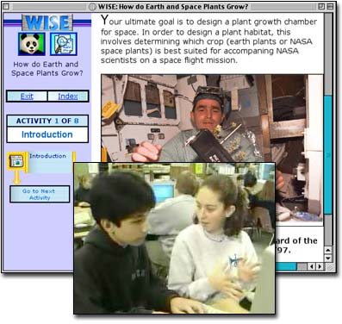
WISE
WISE promotes lifelong learning skills including critiquing, comparison, and design.

Slide 8
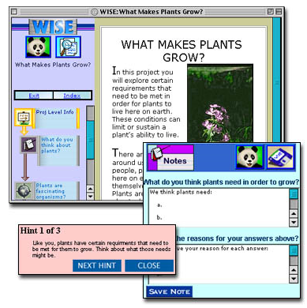
WISE
Software with:
"evidence" web pages with content, "notes" and "hints”
data visualization tool
causal modeling tool
Simulations
on-line discussion tool
Assessment tool

Slide 9
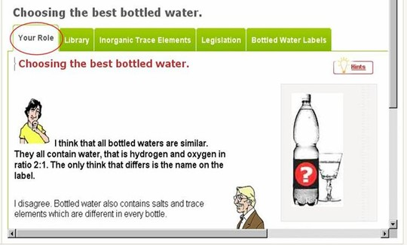
Web-based teaching-learning platform STOCHASMOS - SYNERGASIA
Support students' scientific reasoning through scientifically authentic investigations with an embedded authoring tool.
http://www.stochasmos.org/nqcontent.cfm?a_id=875&tt=Stochasmos&lang=en

Slide 10
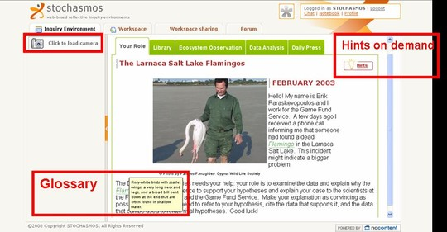
STOCHASMOS - SYNERGASIA
Includes a learning environment for students to be engaged and reflect on their inquiry
Notes:
(a) enables students to engage in open-ended investigations of complex and diverse scientific data according (b) supports students’ reflective inquiry by providing the tools for organizing data to be used as evidence and integrating a space where the data can be interpreted and explained.

Slide 11
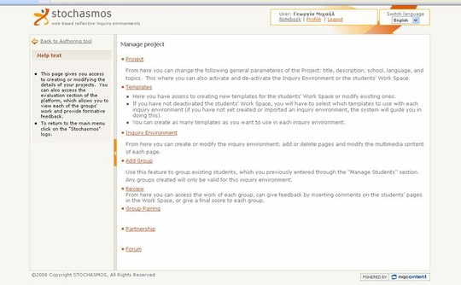
STOCHASMOS - SYNERGASIA
And a authoring system for teacher to adapt or create new learning environments.

Slide 12
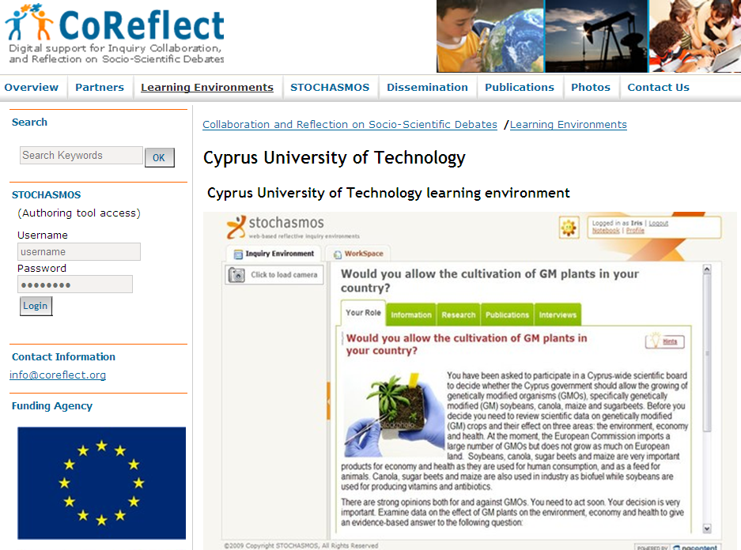
Digital Support for Inquiry, Collaboration, and Reflection on Socio-scientific Debates (CoReflect)
Empirically-tested, web-based library of interactive inquiry environments in socioscientific issues
Notes:
Project started in 2008 and will finish in 2011.
Digital Support for Inquiry, Collaboration, and Reflection on Socio-scientific Debates (CoReflect)

Slide 13
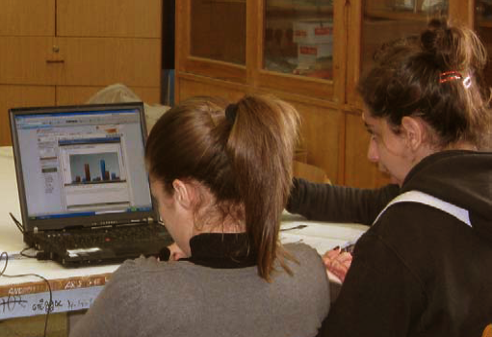
CoReflect
Establish a model for the development of sustainable inquiry digital curricula, involving researchers, scientists, and practicing teachers.

Slide 14
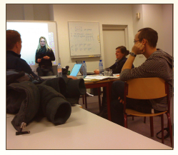
CoReflect
Explore the adaptation process through which best practices can be adapted and transferred from one national or cultural context to another.

Slide 15
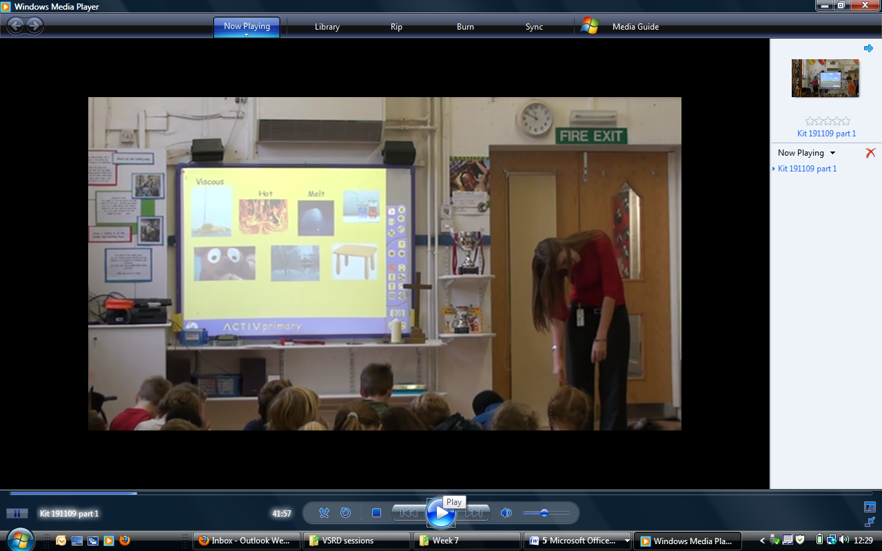
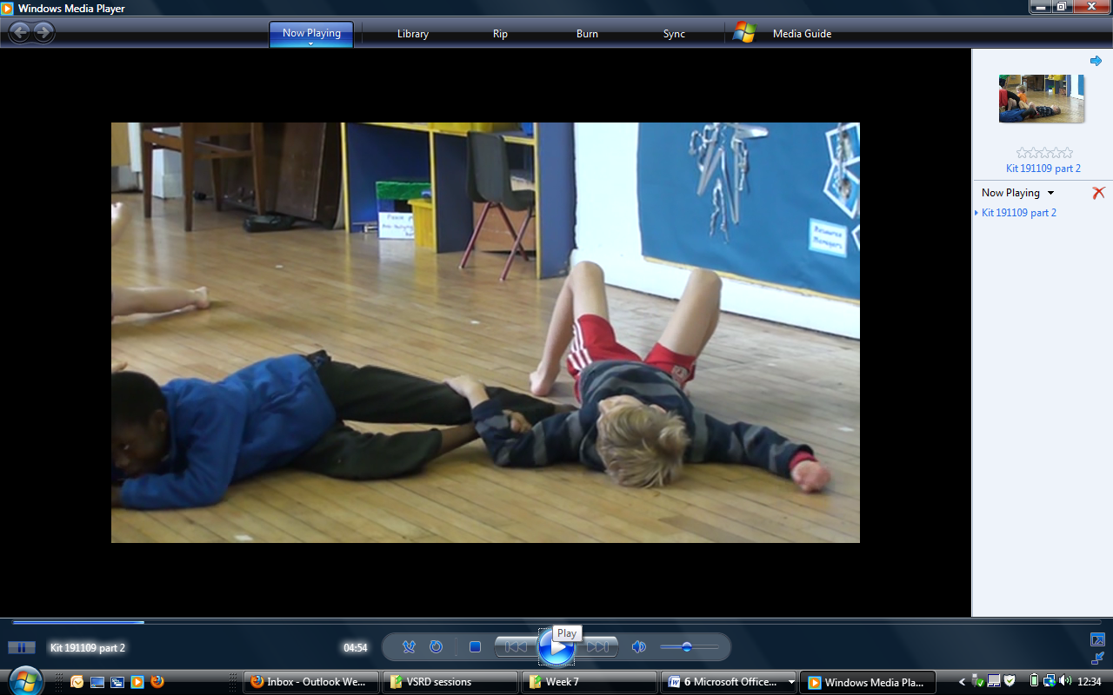
Science and Movement

Slide 16
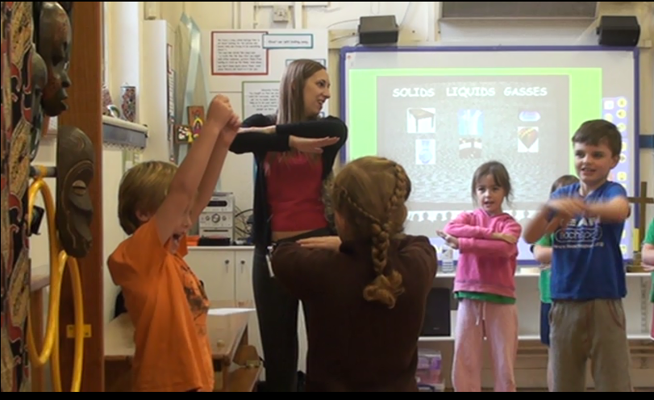
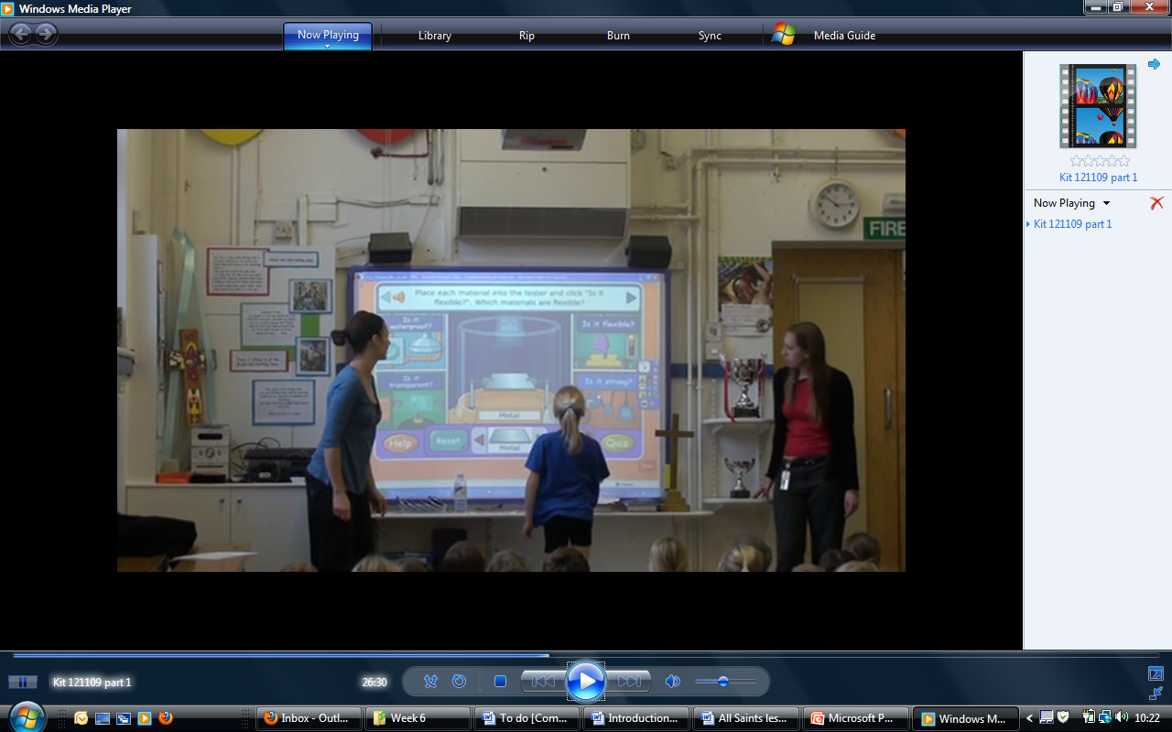

Slide 17
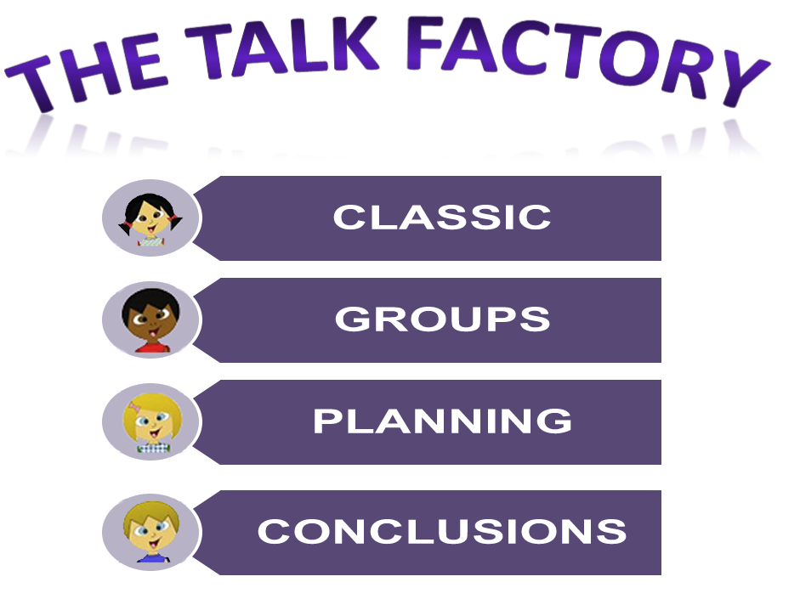
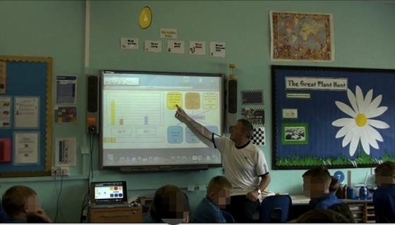
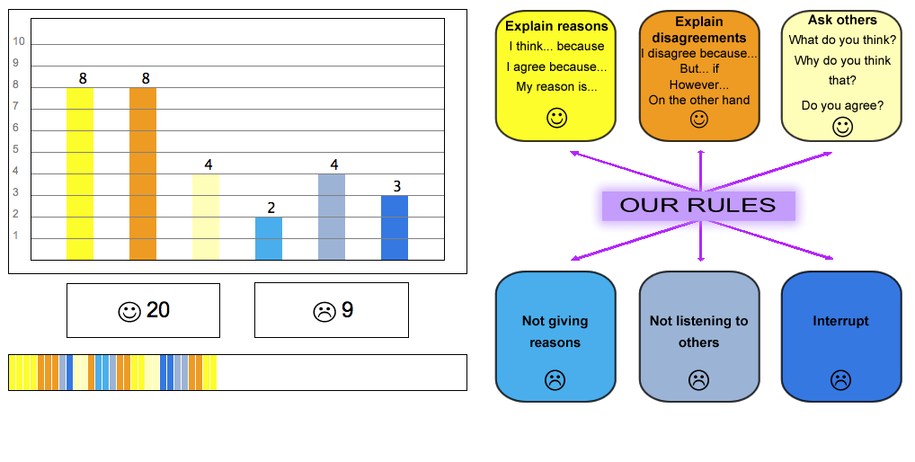

Slide 18

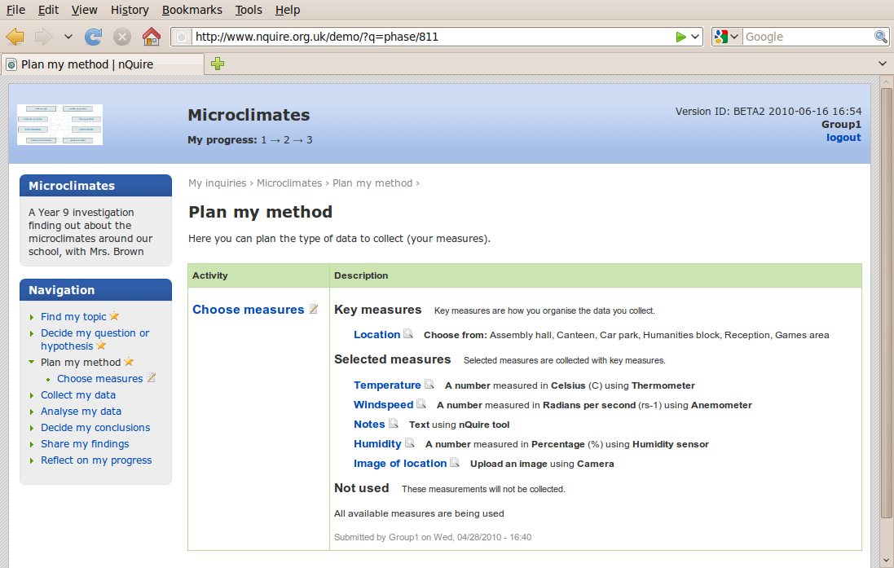
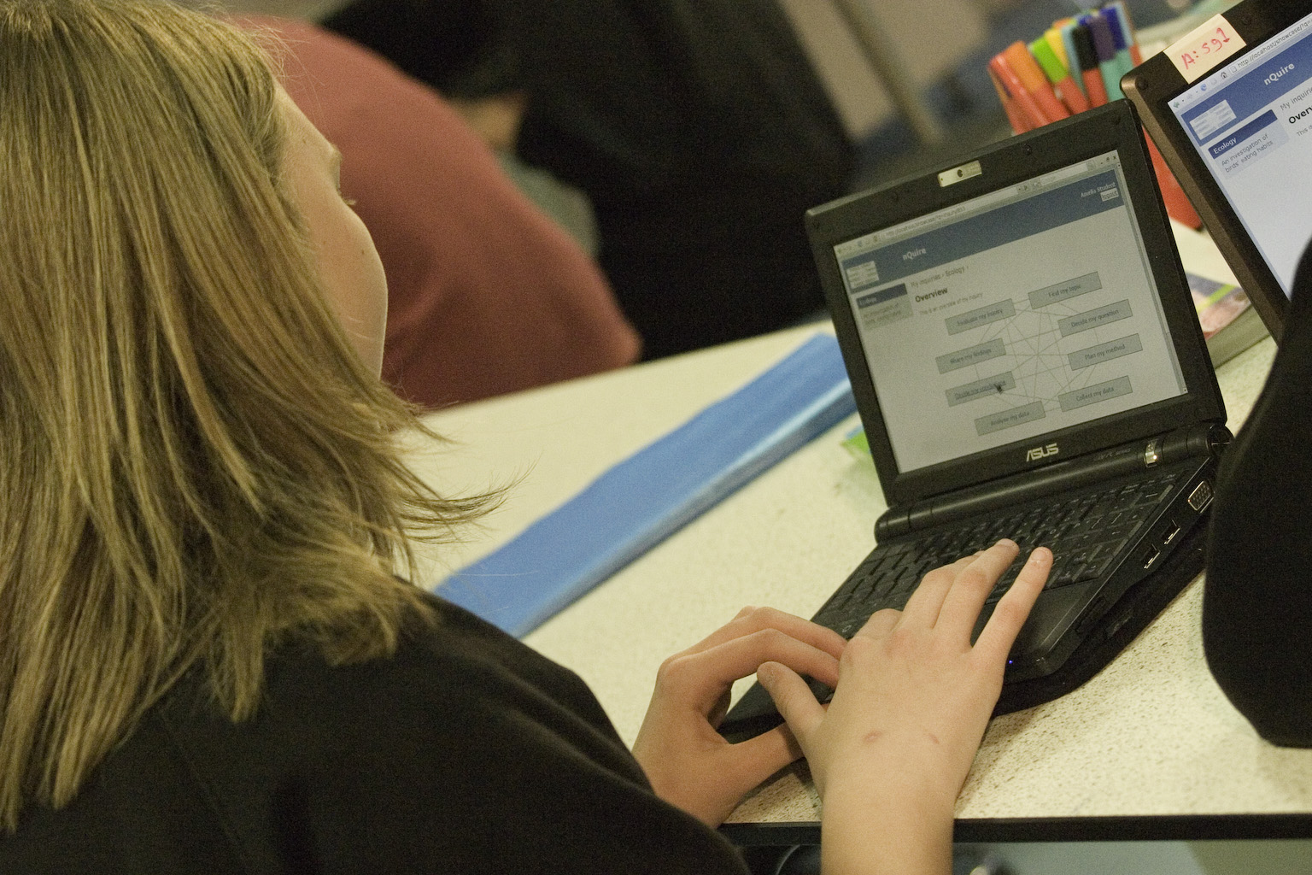
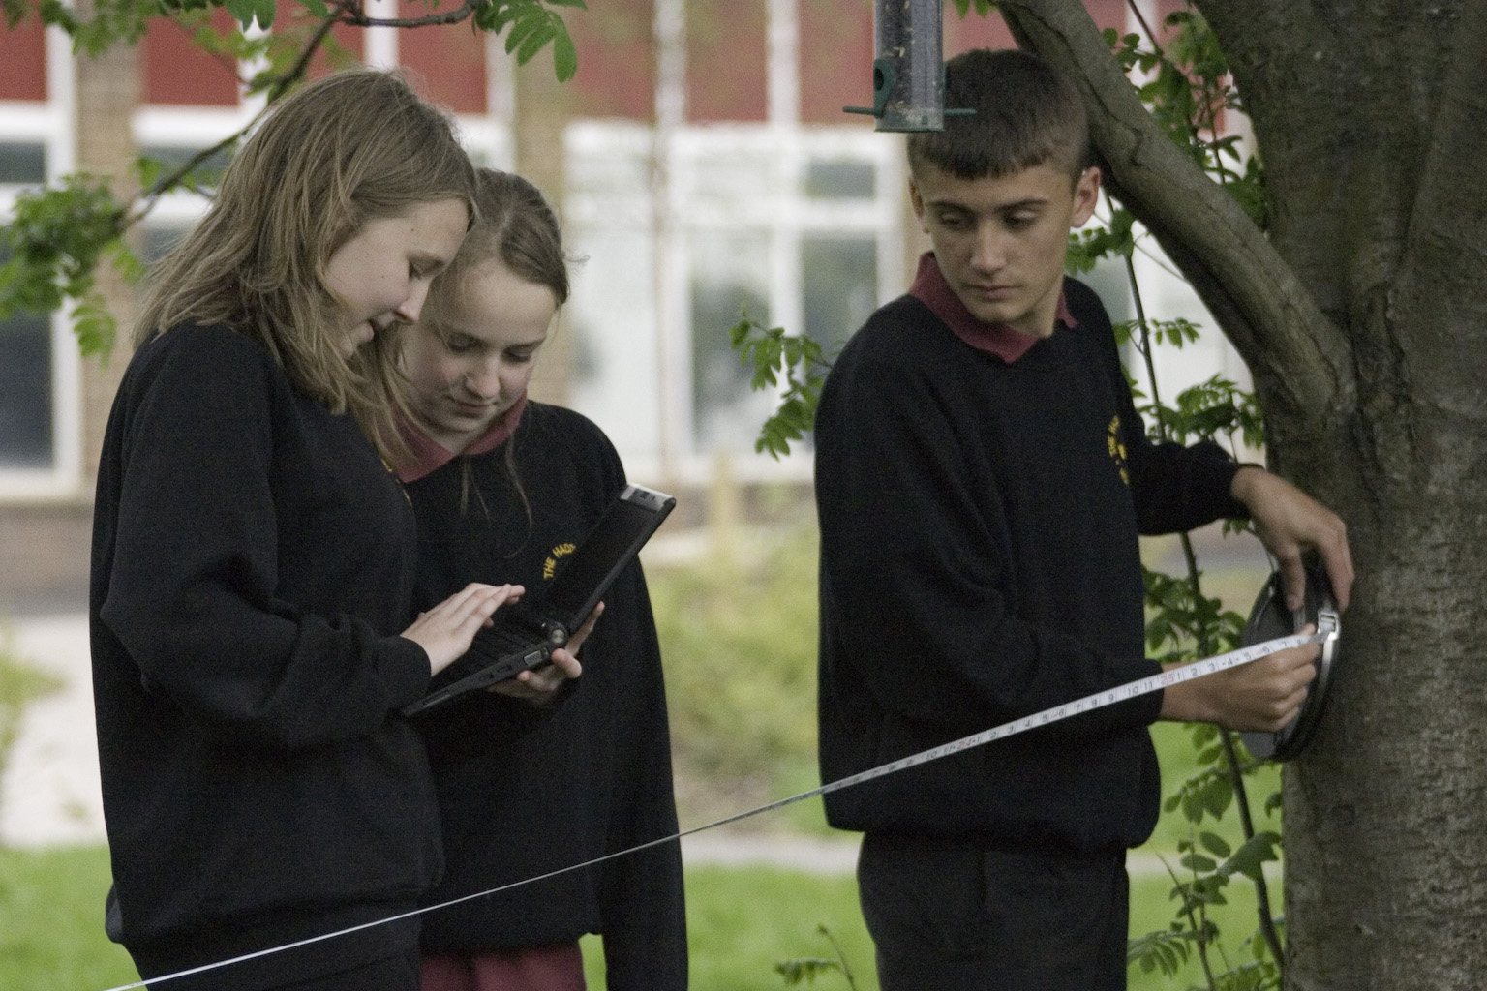
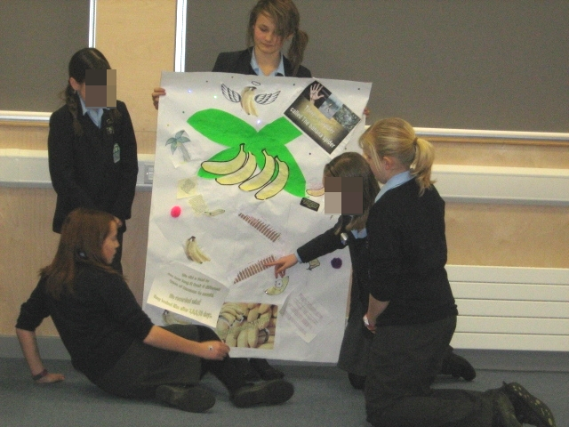
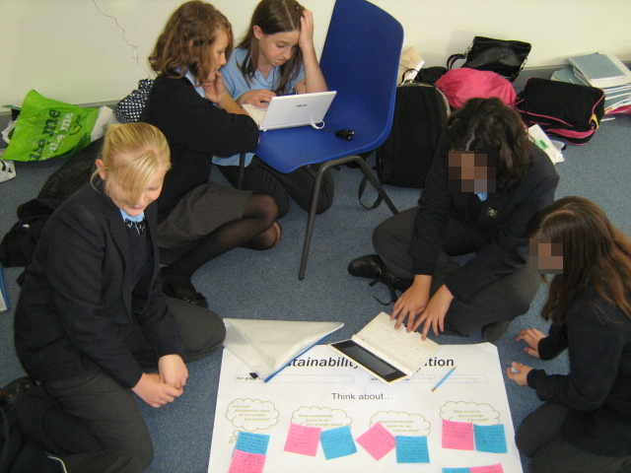
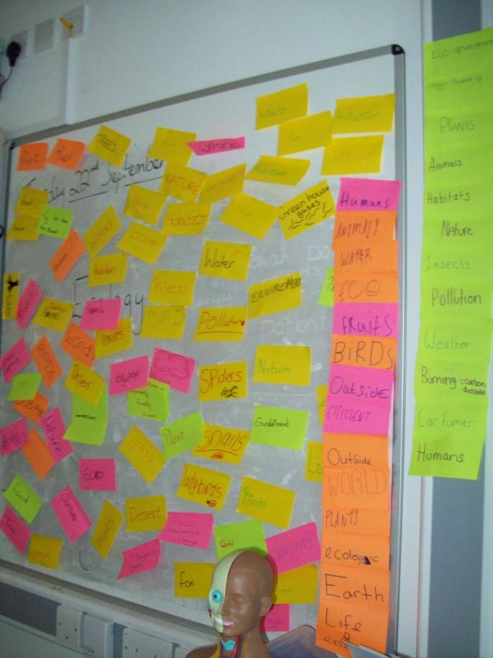
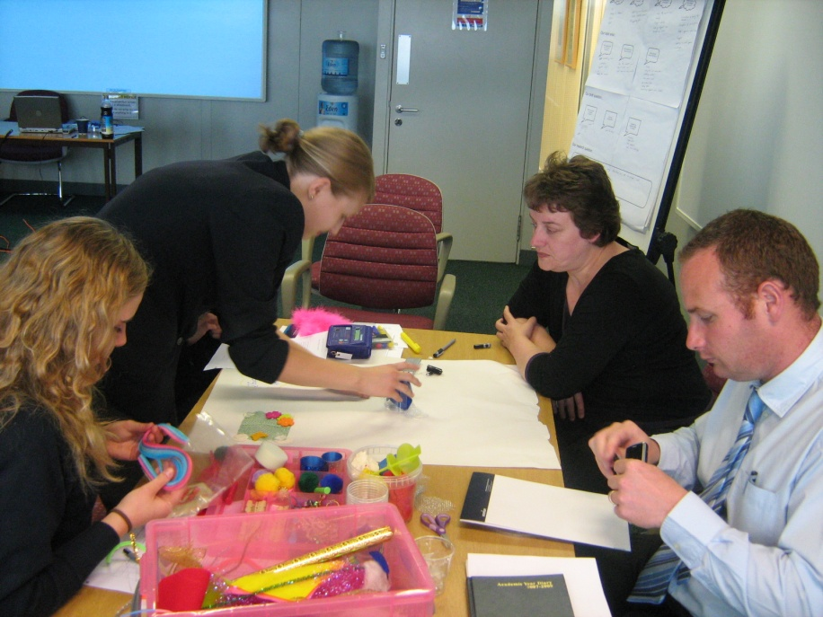
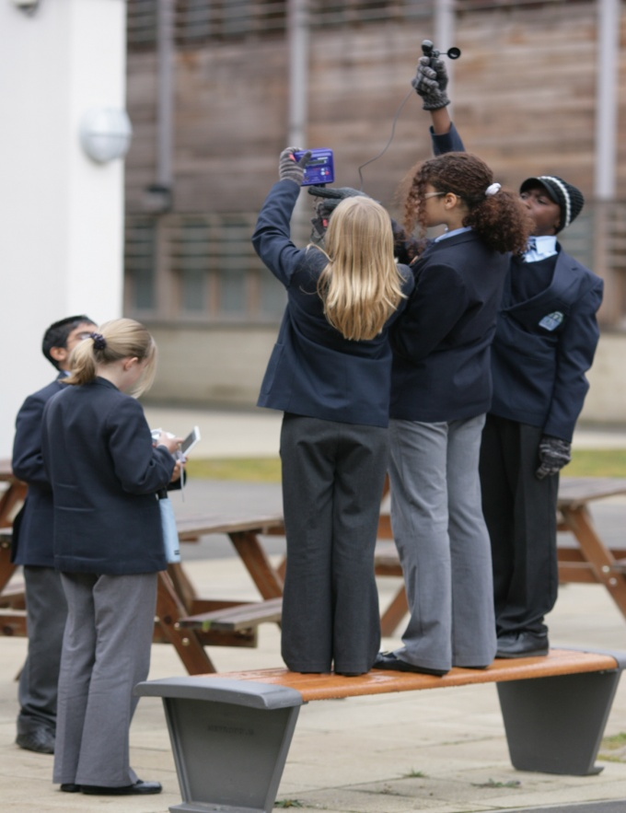
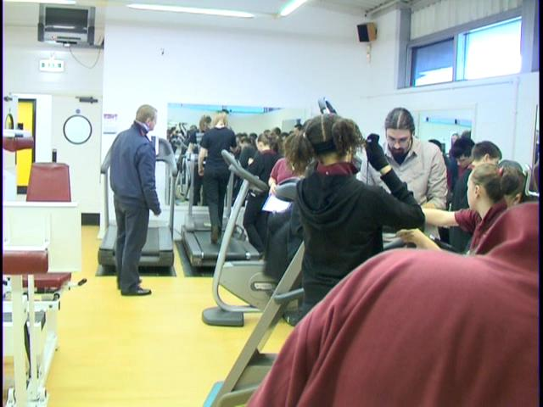





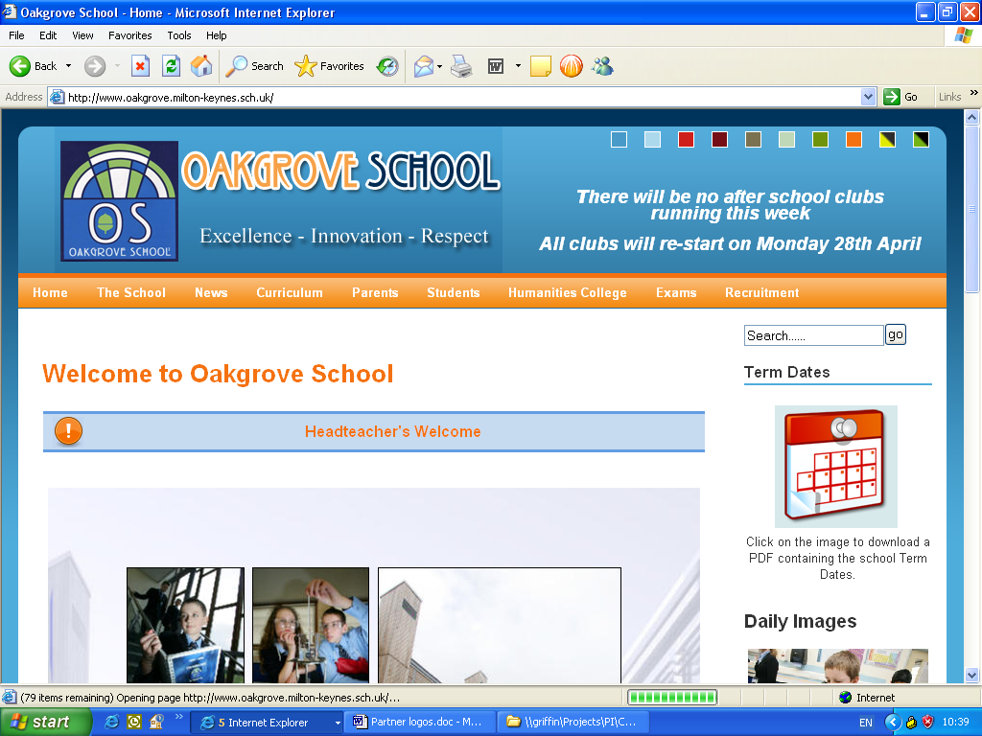

Personal Inquiry
www.pi-project.ac.uk
Scripted Inquiry learning. Scripts are like dynamic inquiry plans, implemented on personal computers, that guide and structure inquiry learning.
Connecting learning across contexts. Evidence-based investigations that start in the classroom, continue in less formal settings and move back to the classroom to share and present results.
Class
Decide what to measure
Decide on our locations
Group
Collect data
Individual
Write my hypothesis
Analyse my data
Stage 1
Stage 2
Decide my conclusions
Stage 3
Participatory design. Involving young learners, teachers, experts and researchers in an iterative process of proposing, designing and running novel evidence-based inquiries.
Personally meaningful inquiry. Investigations that relate directly to the needs and curiosities of learners. Thinking about everyday ideas in new ways.
How does global trade impact upon what I eat at different times of the year?
My
Environment
How is land used to provide food for my community?
Do I really need all the packaging on the food I eat?
How does the food waste produced by my community affect the global environment?
Myself
My
Community
How can shops help me to be more sustainable?
How can I contribute less waste to my community?
www.nquire.org.uk

Slide 19

What about the teacher?
Lack of technical support
Cognitive overload
Little room to manoeuvre
Drowning in data
More change!
Will it support the students’ learning?

Slide 20
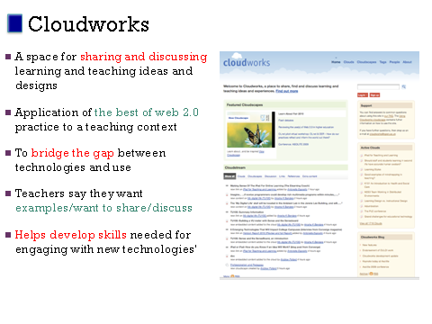

Slide 21
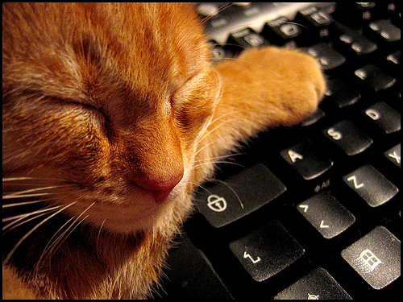
The Net Generation: It’s boring dude
HE and school software doesn’t hack it
Free software
Sharing expertise
Experts in story telling about cool software
Sharing
Show and tell
Take advantage of the moment

Slide 22
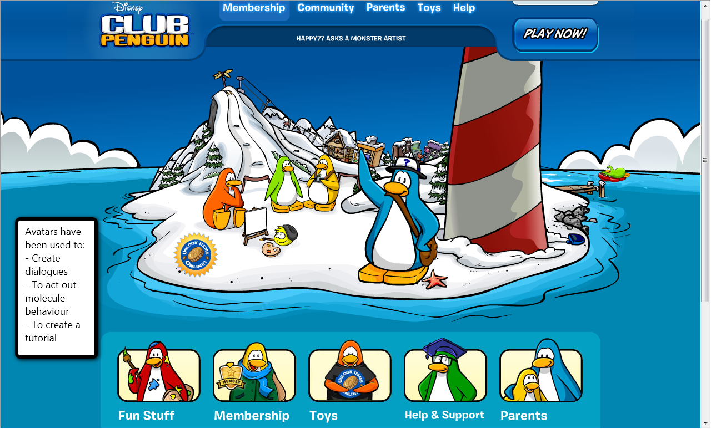
Club Penguin: Free Disney Virtual space with avatars http://www.clubpenguin.com/
DMW, Barcelona, Oct 2009

Slide 23
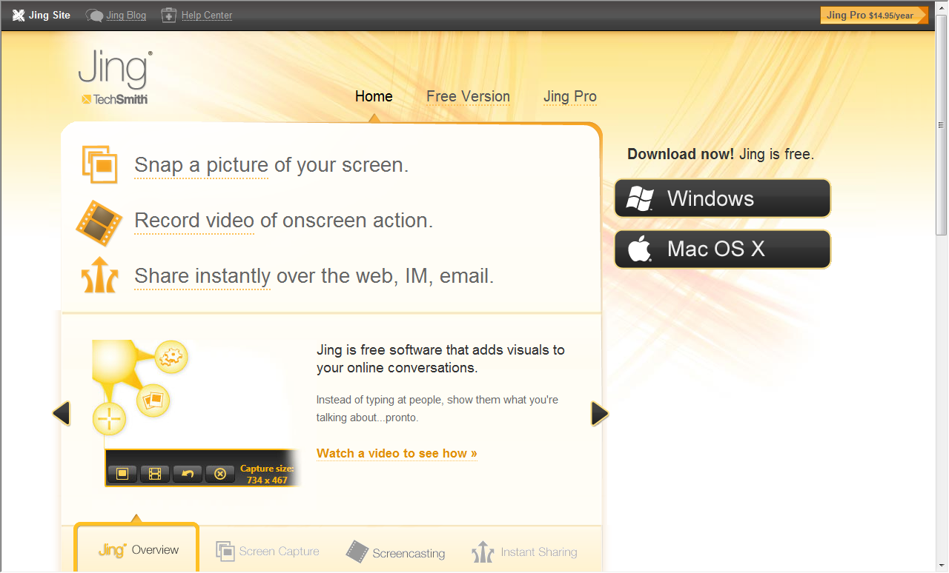
Jing: A screen sharing application http: //www.jingproject.com/
DMW, Barcelona, Oct 2009

Slide 24
Jing: A screen sharing application http: //www.jingproject.com/
DMW, Barcelona, Oct 2009

Slide 25
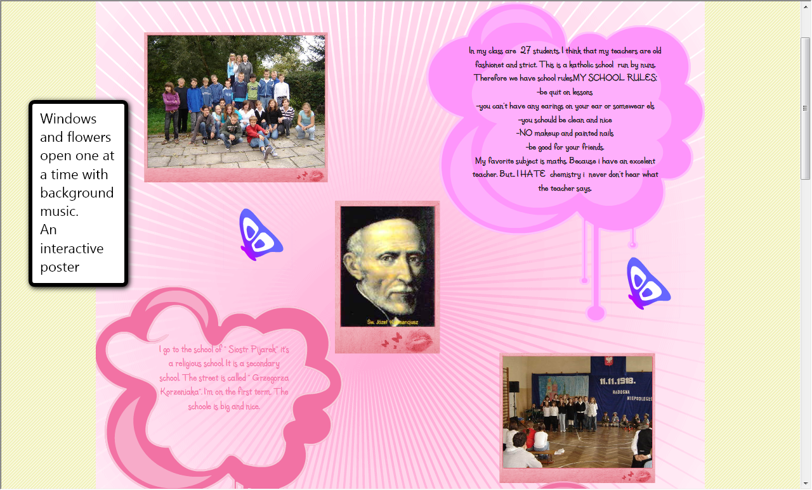
Glogster http://www.glogster.com/
Interactive poster
Facilitates a narrative
Can capture in an interesting way key points from a lesson
DMW, Barcelona, Oct 2009

Slide 26
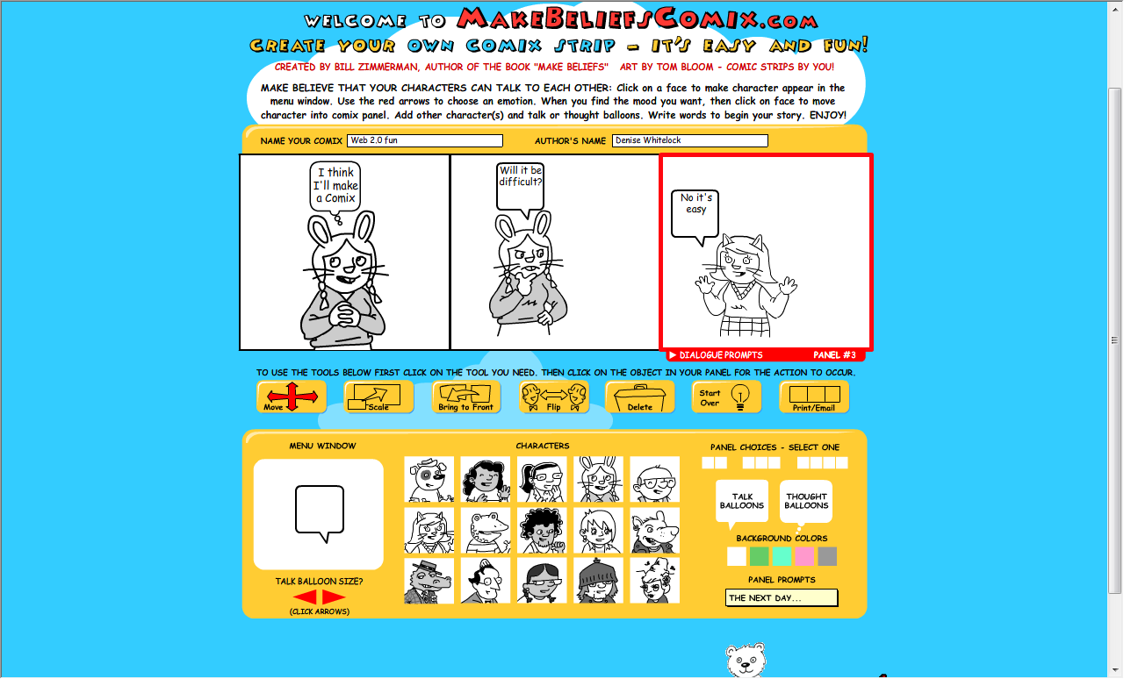
http://www.makebeliefscomix.com/Comix/
DMW, Barcelona, Oct 2009

Slide 27
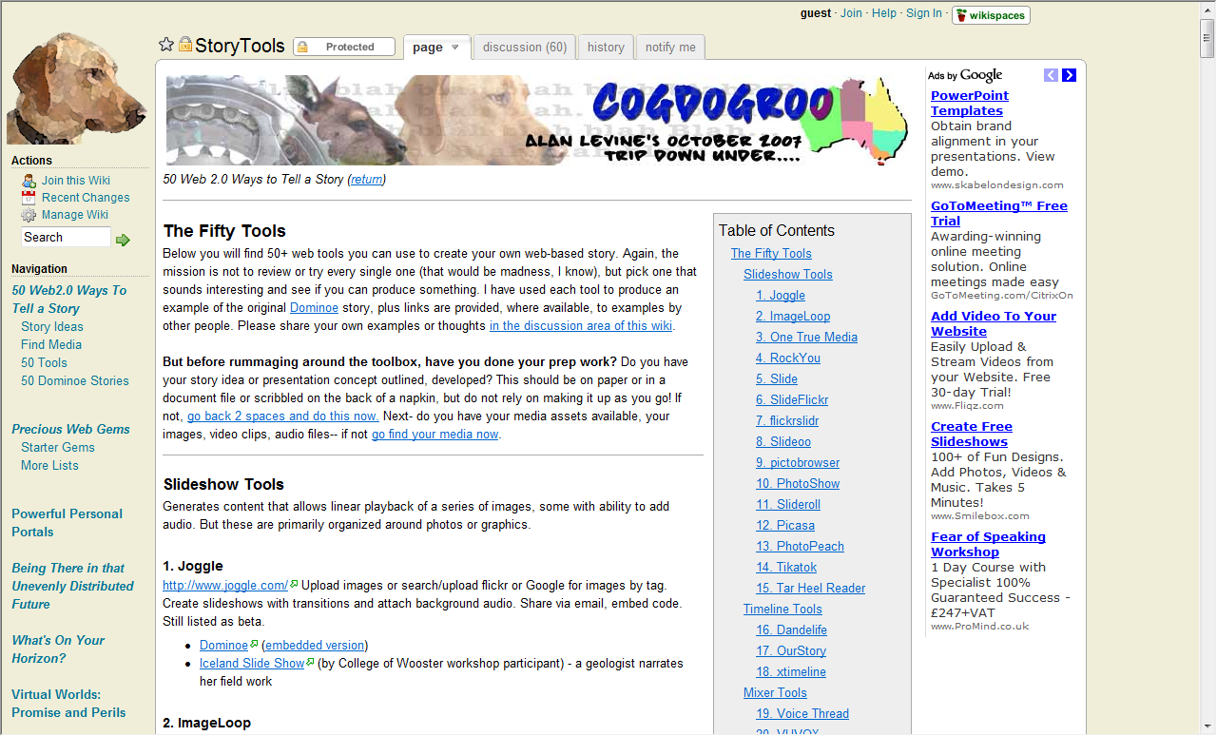
Story Telling Tools: http://cogdogroo.wikispaces.com/
Wide range of Web 2.0 Tools
Let the kids choose how they want to tell their learning stories
Sharing, retelling and editing, all part of reflective practice
DMW, Barcelona, Oct 2009

Slide 28
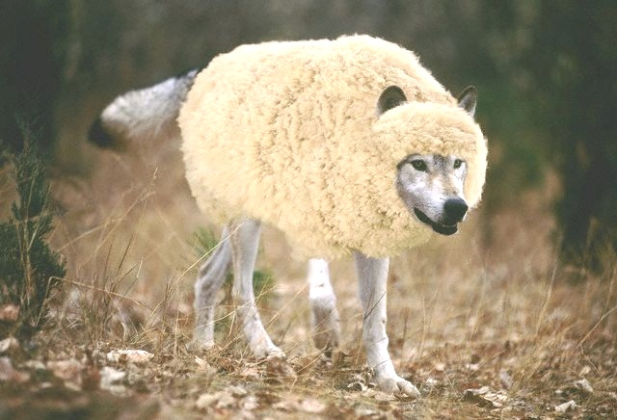
Constructivist rhetoric: wolves in sheep's clothing

Slide 29

Assessment
Rethink learning design
Authentic assessment
Work in team & assessed individually
Peer
Advice for Action
Socio e-emotive content
Maintain empathy with the Learner
Androgogy?
DMW, Loughborough, July 2009

Slide 30
Science as a theoretical test-bed
Muti Modality
Kress
Exploratory Talk
Mercer and Scott
Science Test Bed
Improvable Objects
Twining et al
Arguementation
Wegrif

Slide 31
What is about Science ?
Interactivity
Multi representational
Causality
Can be modelled
Deconstruct ideas
Problematise
Builds tools
Open to test
Easier to judge /prediction
Why aren’t we contributing learning theories more?

Slide 32
The 4Ts Pyramid
Transfer
Learning
Transformation
Tasks
Training of staff
Tool Development

Slide 33
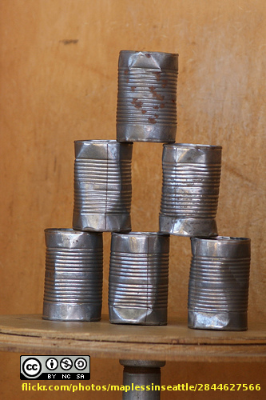
Rearranging
Reduce cognitive overload of all singing and dancing systems
Open source
Promote prominence of assessment in learning Design
Teacher support/training
Tools and modelling of too much data for us all
Socio-emotive response
Pushing theory

Slide 34
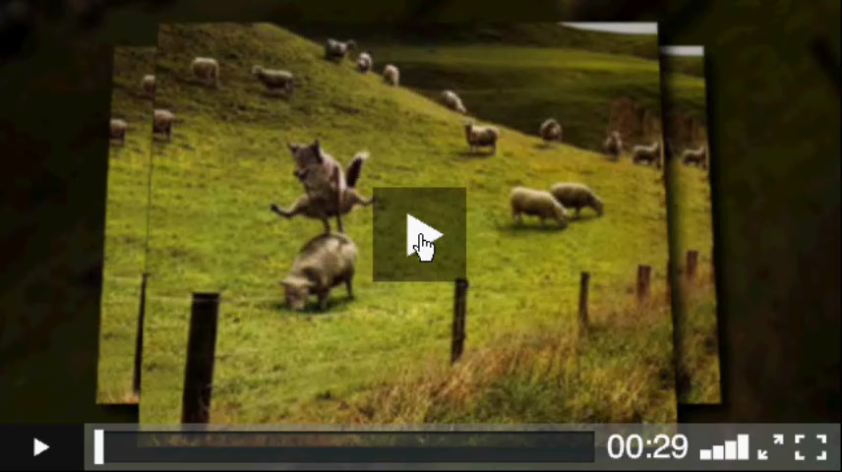
DMW November 09

