Slide 1
Observing the Seen and the Unseen: Computer & Social Mediation of a Complex Biological System
Catherine Eberbach & Cindy Hmelo-Silver
Rutgers University
Notes:
This study is:
-part of a larger design research study in which our research group is developing 3 curriculum units to help middle school students gain deeper understanding of complex aquatic systems.
-pre/posttest measures that tell us we are moving in the right direction
-Even so, this is an exploratory study…
-that will help inform design decisions
-that sets the groundwork for a microgenetic study in which we look closely at the mechanisms that support complex understanding of complex aquatic systems in this learning environment.

Slide 2
Exploring Observation of Complex Systems
Scientific Observation is a complex practice
Learning to observe scientifically is rarely the focus of learning research
Learning to observe complex systems is challenging
Computer-supported tools can support inquiry, but may be an insufficient condition for learning
Knowledge is socially constructed
(e.g., Assaraf & Orion, 2005; Chi, DeLeeuw, Chiu, & La Vancher, 1994; Daston, 2008; de Jong & Joolingen, 1998; Eberbach & Crowley, 2009; Palinscar, 1998; Smith & Reiser, 2005; Tabak, 2004)

Slide 3
Research Questions
How can computer tools and social mediation support student observations of a complex biological system?
What role do teachers’ questions play in mediating student observation of complex systems?

Slide 4
Study Participants
Notes:
Part of larger design research study
7th graders in a suburban middle school
Learning about an aquarium system (the 1st curricuculum unit)
Case Study of one group of girls
Mary, Shruti, and Erica -- 2 European-Americans and 1 Indian-American descent
Ms. G, experienced science teacher

Slide 5
Computer Tools
RepTools hypermedia
Uses function-oriented questions
NetLogo simulations
Fish Spawn: observe macro level
Nitrification Cycle: observe micro level
Aquarium Construction Tool (ACT)
Identify behavioral & functional relationships
Create models
(e.g., Liu & Hmelo-Silver, 2009; Wilensky & Reisman, 2006)

Slide 6
Data & Analysis
Data Sources
Videos of students & teacher using computer tools
Researcher field notes
Student generated models and worksheets
Analysis
Iterative deductive approach
Analyze discourse with a focus on questions
(e.g., Abrams, Southerland, & Cummins, 2001; Derry et al, 2010; Powell, Francisco, & Maher, 2003)

Slide 7
Fish Spawn: Observing the Macro Level
Notes:
In Episode 1, Ms G begins by orienting students to the Fish Spawn simulation screen, designed to explore the relationships between fish populations and water quality.
Describe the screen – variables, controls, graph, outputs, fish… and yellow squares
As Ms G introduces the simulation, the girls are busy messing with the simulation.
Shruti asks…. Next Page

Slide 8
“What are all those yellow things?”
Shruti: They (fish) get a lot of food. Is the yellow the food?”
Ms G: Is what-
Shruti: / /yellow the food?
Erica: Is the yellow the eggs?
Ms G: No.
Shruti: Is it the food?
Ms G: No.
Mary: Then what is it? The algae?
Notes:
Ms G stops by the table where the girls are working and asks how they are doing.
Read dialogue.
At this point the teacher goes to another group, and the girls start a new iterative cycle. They notice behaviors and make some guesses (waste? O2?). This pattern continues for some time.

Slide 9
“Why are the fish dying?”
Shruti: The number (of fish) eaten keeps going up!
Erica: Now the total fish is 76.
Shruti: Who’s eating the other fish?
Erica: 92! Oh! We just got more. 112!
Shruti: Why are so many fish getting eaten? It says poor water deaths.
Erica: 132!
Shruti: All the fish are dying from poor water too.
Mary: Poor water? We have good water! We changed it like a million times!
Shruti: No, I made the water quality 100—1,000% (refers to water flow)
Notes:
The simulation screen is quickly filling with yellow squares when Erica observes, “none of the fish are dying from no food.” Having previously noted that so many fish deaths are related to being eaten, the girls now notice that the fish are also dying from poor water quality. Shruti cannot figure out why fish are dying from poor water quality, even though she has increased water flow. What else can cause the water to be—in Shruti’s words—“so disgusting?”
Clearly, the girls are beginning to notice patterns of behavior. The data outputs are providing information but they are having trouble connecting the data to the to the behavior of the phenomena on the screen.

Slide 10
“Why is the water so disgusting?”
The girls make independent observations without making connections:
Mary: “…the yellow in ganging up in places where the fish aren’t.”
Erica: “None of the fish are dying from no food”
Notes:
The girls make independent observations without making consolidating their observations. They do not make connections to the complex behavior evident on the screen.
Mary: read quote. But she doesn’t also notice that the fish population is also getting smaller even as the water quality is getting worse
-Not making connections between changes in fish population and water quality.

Slide 11
Starve the Fish!
Shruti: I want the fish to die from food death.
Observing the simulation and data outputs:
Mary: But the yellow goes away when there’s less food. But she (the teacher) said it wasn’t the food!”
Notes:
At this point, Shruti notices the teacher’s simulation on the Smart Board is in equilibrium. It looks a lot different from their simulation.
It has few yellow squares and no poor water deaths.
Without talking with the other students, reduces the amount of food available to the aquarium.
The girls observe the screen together, at which point Mary notices – in some frustration –
READ dialogue
At this point, it is worth noting that the teacher was mistaken in her interpretation of the simulation. She had thought the yellow squares were fish waste. The girls are struggling to coordinate their observations with the explanation –AUTHORITATIVE– explanation of the teacher.
They now become very focused on manipulating the levels of food and observing it’s effect on the aquarium AND on the presence and absence of the yellow squares.

Slide 12
Eureka!
Mary: We have no food.
Shruti: Of course we have no fish.
Ms G: …the yellow patches, I think they are the food. I was thinking they were the waste. But I think they’re the food. But if you think about it, the waste would probably be similar. They don’t show the waste apparently. But it would be a similar amount if they’re eating that food. It’s gonna be converted into waste.
Shruti: I thought it wasn’t waste because when the baby fish went over it, it started disappearing.
Ms G: It did? Ok. So, good.
Notes:
The teacher returns to the table and asks the girls is they have identified the yellow squares.

Slide 13
Fish Spawn Summary
Simple identification questions can filter complexity & stimulate productive observations of complex behaviors.
To interpret behavior, students & teacher repeatedly observed the simulation to make connections between data outputs and behavior.
Students begin to make connections between the visible parts of a system and the invisible parts.

Slide 14
Observing the Micro Level: “Why are the fish dying?”
Notes:
Episode 2…
-reflection: why were the fish dying?
-Is there soemthing about the water quality –”microsystems”
Here, with the abstract shapes, they begin asking “what is it” questions

Slide 15
“What are the red dots?”
Shruti: What are the red dots?
Mary: I don’t see any fish. [Pause = 4 seconds] Are the red dots the ammonia?
Ms G: Well um why did you say that?
Mary: Because the ammonia was going up and there was more red dots.
Ms G: Did you hear what Mary said? She noticed that as she saw red dots the ammonia level in the graph was going up. (points to graph)
Notes:
Reading the outputs and making connections right away to identify some of the abstract shapes and color.s

Slide 16
“Did you figure out what those patches are?”
Shruti: I have no idea—Maybe they’re the bacteria?
Erica: Blue? Teal?
Shruti: Maybe they’re the different types of bacteria?
Ms G: How could you figure that out?
Shruti: I don’t know. (laughs)
Ms G: What if you started again and really looked at when those patches start to appear, the timing of the patches, then look at the other data (points to screen). What’s happening when those chemicals start to build? How does the appearance of those patches um relate to the chemicals?
Notes:
Coordinating observational practice with domain knowledge proves to be rather challenging.
The teacher makes several moves that facilitate productive observations of the nitrification simulation of the nitrification cycle. Previously, she suggested slowing the simulation to see what is really happening and checking out content in the hypermedia to identify the colored patches. Now, she cues them to associate the timing of the appearance of the colored patches with difference in chemical levels (i.e., ammonia, nitrite, nitrate). The girls start a new cycle and closely observe the screen, waiting for the patches to appear:

Slide 17
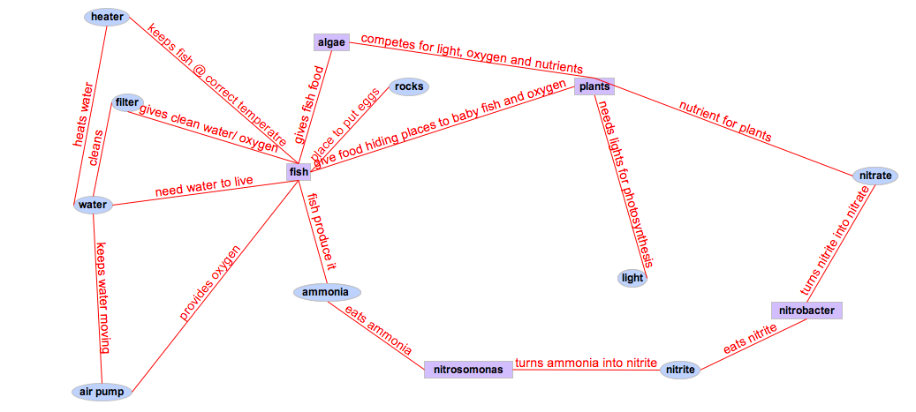
Final Model of an Aquarium System
Notes:
Did they make connections? Understand a complex system?

Slide 18
Modeling Connections: “Ammonia poops?”
Erica: Pooing?
Shruti: That’s how they get rid of their waste (laughs).
Erica: Ammonia poops?
Mary: Ammonia’s in their poo.
Erica: Then why does it say pooing? That isn’t how.
Notes:
In reality however, creating the model generated very little talk among the girls.

Slide 19
Discussion
Computer & social mediation is synergistic
Centrality of asking questions
Design should facilitate learning in complex inquiry learning environments in ways that enable learners to observe the effects of their actions and to observe multiple dimensions of complex systems.
Notes:
The combination of a computer learning environment and teacher mediation provided an integrated system of support for student learning.
The kinds of questions used by the teacher during computer-supported inquiry played a key role in the kinds of questions students also asked and their ability to observe features and behaviors of phenomena in ways that begin to distinguish scientific from everyday practice.

